Slide 1
CSML1010 – Milestone 2
Group 11 – Alex Fung and Patrick Osborne
Instructor – Dr. En-Shiun Annie Lee

Slide 2


Twitter US Airline – Sentiment Analysis
Milestone 2
Model Benchmarking
Hyperparameter Optimization
Ensemble Methods
Analysis and Model Selection

Slide 3

Twitter US Airline – Sentiment Analysis
Combined Feature Engineered Dataset
Data is fully numerical now
Engineered Features
E.g. Emojis/Emoticons
Hashtags
Etc.
GloVe Word Embeddings
(300 dimension)
Binary response variable

Slide 4


Model Benchmarking – Supervised Learning
Supervised Models (Classification)
K Nearest Neighbors
Decision Tree
Support Vector Classifier
Gaussian Naïve Bayes
Logistic Regression

Slide 5
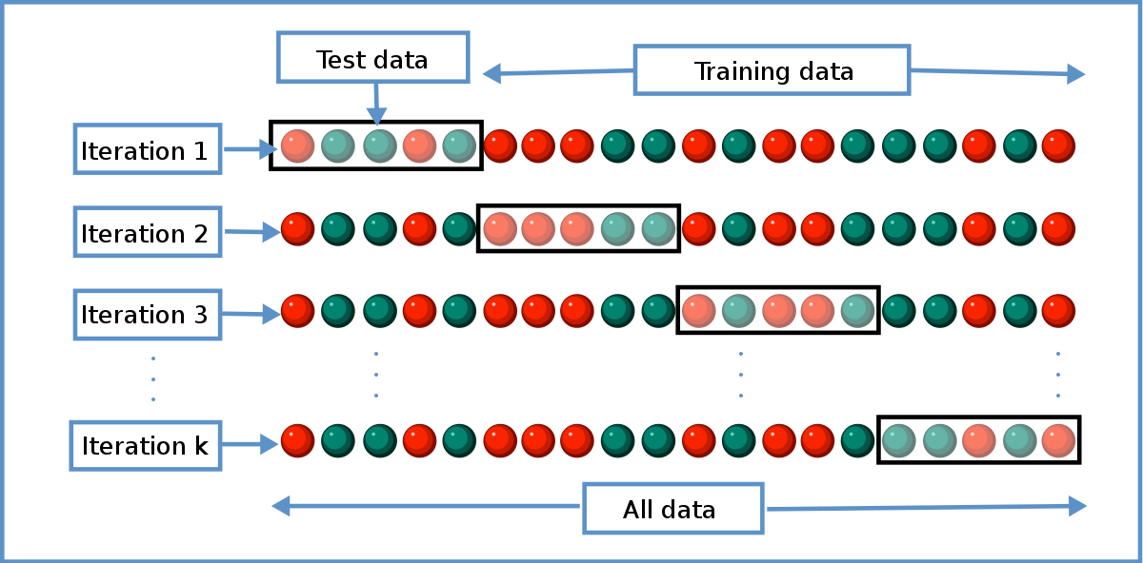
Model Benchmarking - Execution
Stratified K-fold Cross Validation
Using sklearn
Various Scorers:
Fit time, Score time, Bal. Accuracy, F1 score, F2 score, Precision, Recall, ROC-AUC

Slide 6
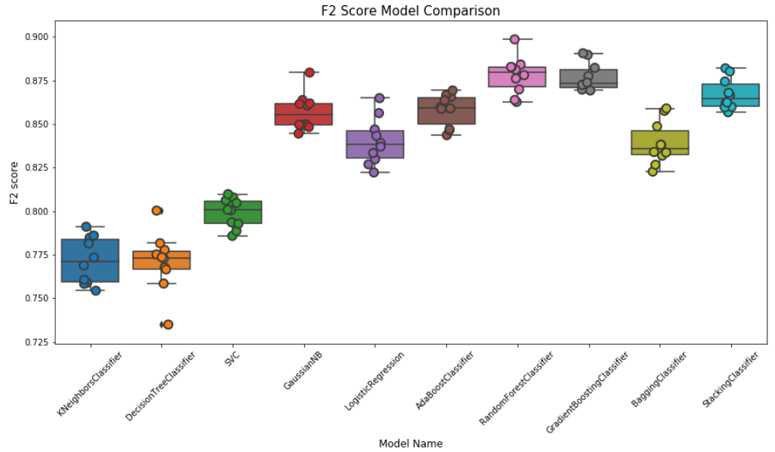
Model Benchmarking – F2 Score

Slide 7
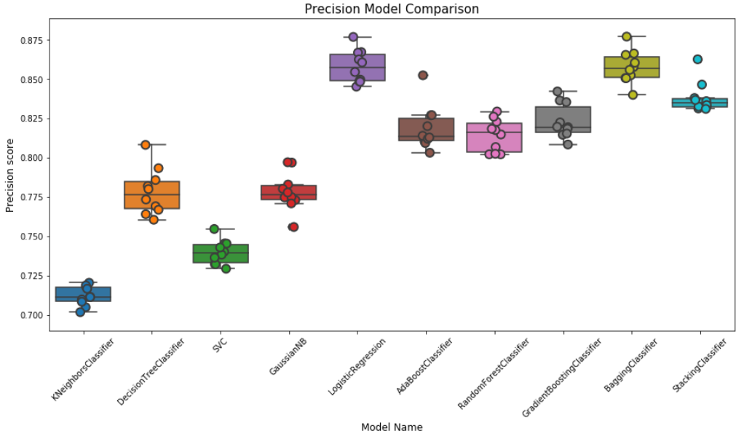
Model Benchmarking – Precision

Slide 8
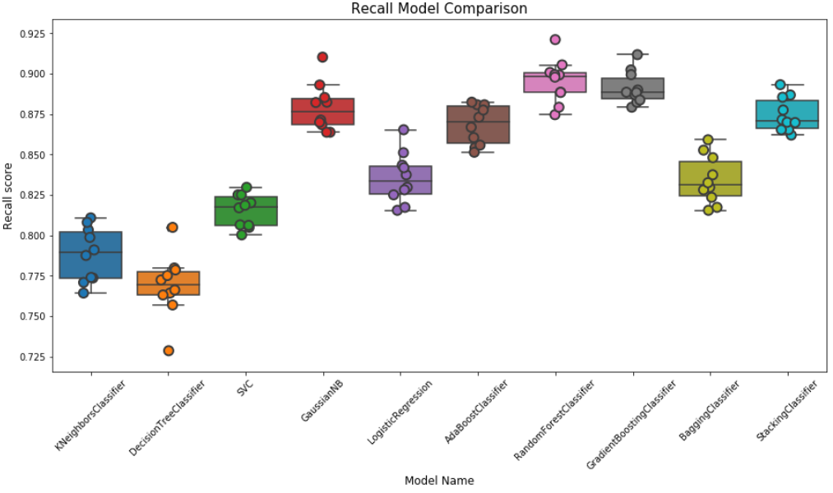
Model Benchmarking – Recall

Slide 9
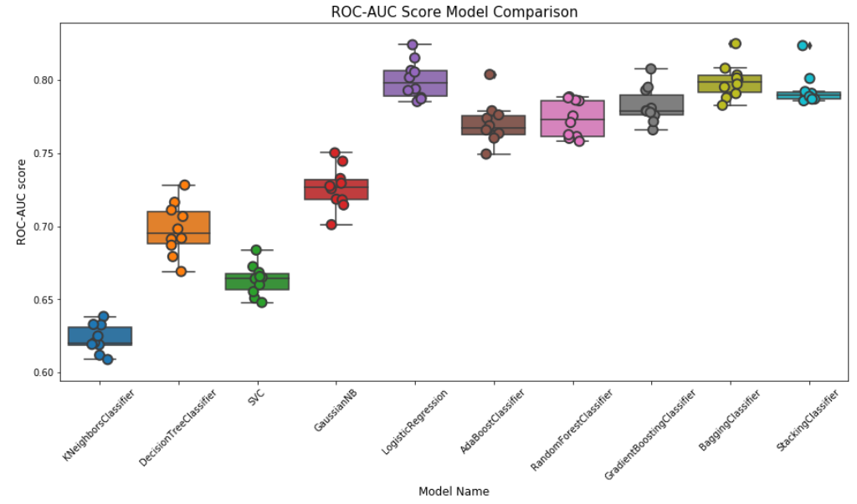
Model Benchmarking – ROC-AUC

Slide 10
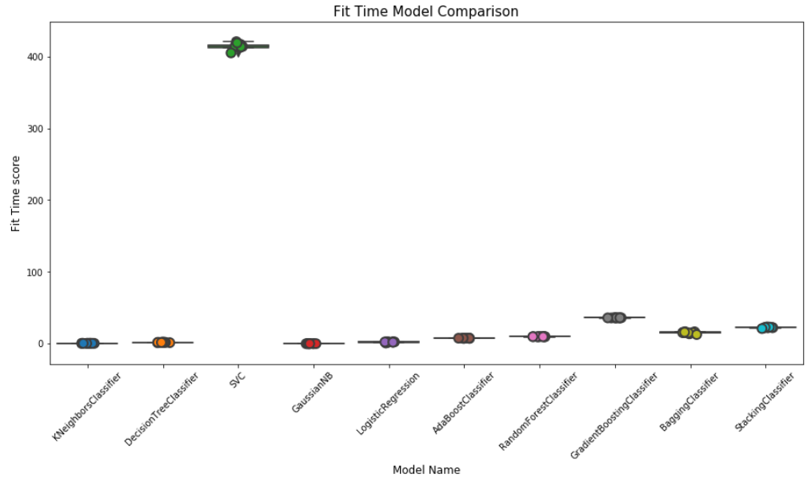
Model Benchmarking – Fit Time

Slide 11
Hyperparameter Optimization
Grid Search
Exhaustive test of parameters from a specified list
Time consuming, but certain to provide the best set of parameters
Random Search
Random search of provide parameters
Faster but could possibly miss some combinations of parameters

Slide 12
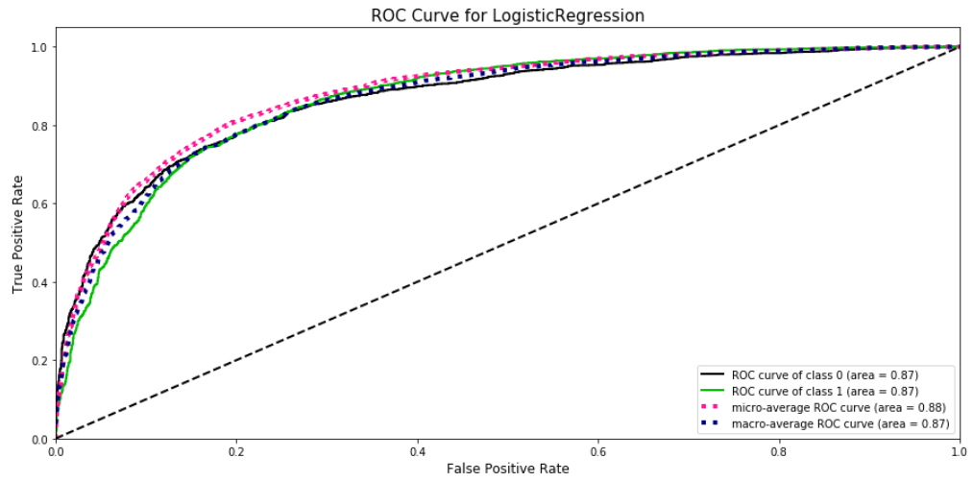
Hyperparameter Optimization
Logistic Regression – Pre-Optimization

Slide 13
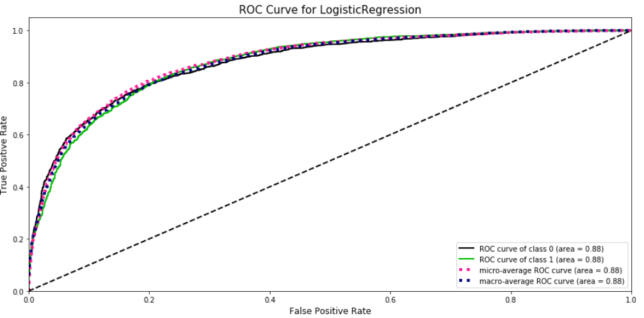
Hyperparameter Optimization
Logistic Regression – Post-Optimization

Slide 14
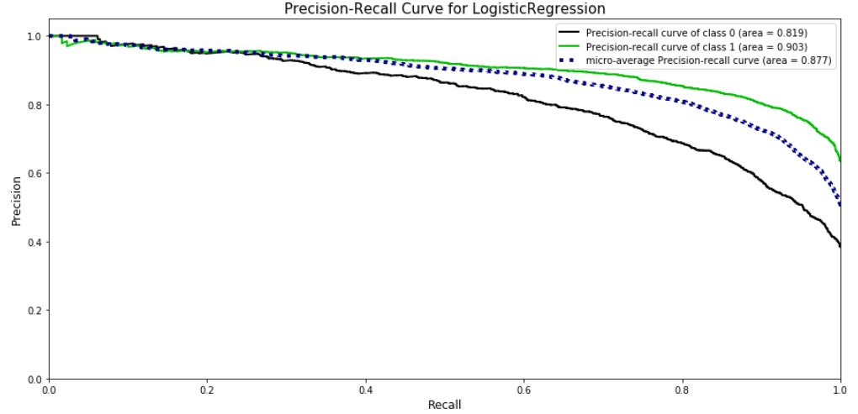
Hyperparameter Optimization
Logistic Regression – Pre-Optimization

Slide 15
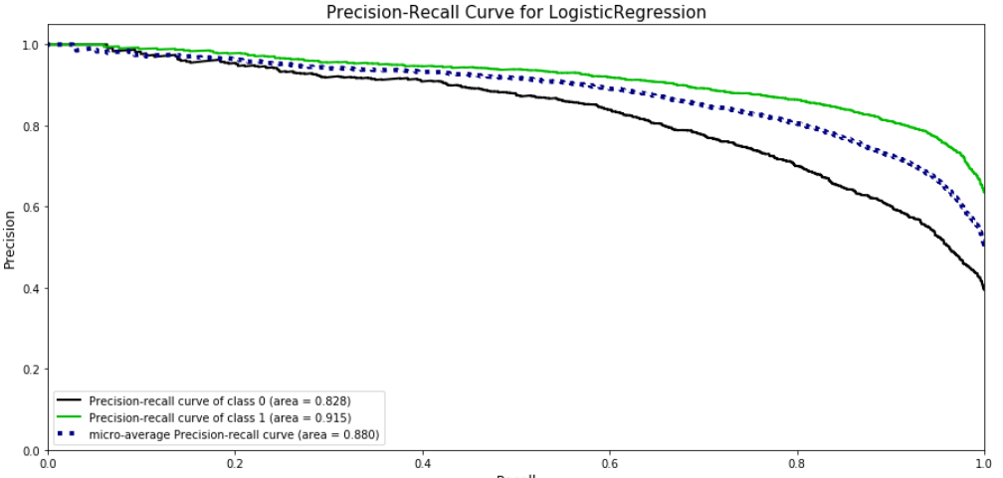
Hyperparameter Optimization
Logistic Regression – Post-Optimization

Slide 16
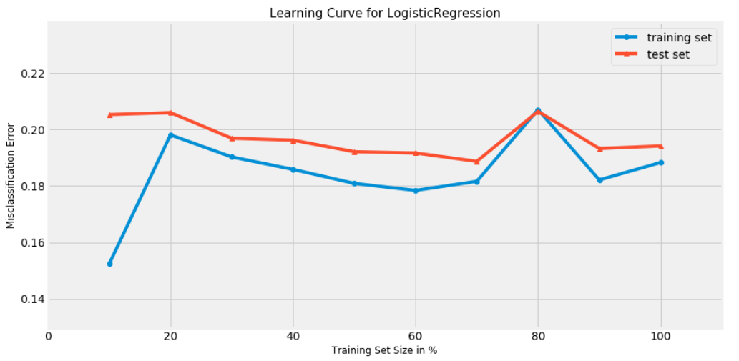
Hyperparameter Optimization
Logistic Regression – Pre-Optimization

Slide 17
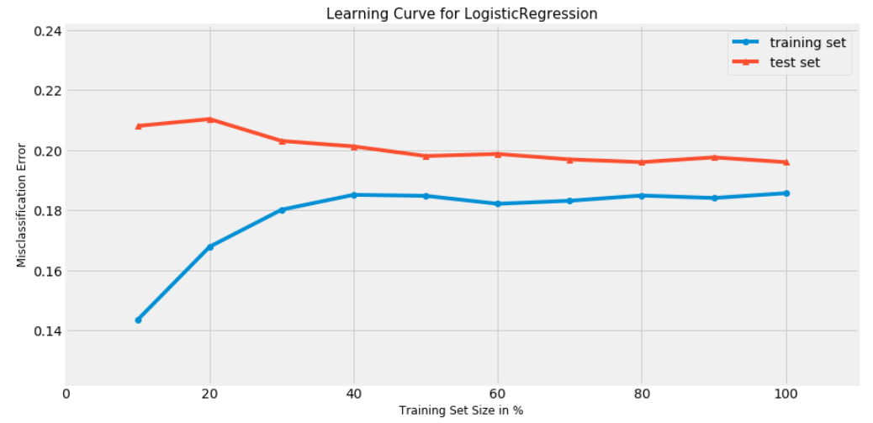
Hyperparameter Optimization
Logistic Regression – Post-Optimization

Slide 18
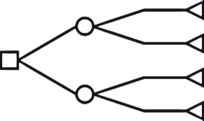
Ensemble Methods
Boosting
Gradient Boosting Machine
Ada Boost
Bagging
Random Forest
Bagging Classifier
Stacking
Stacking Classifier (sci-kit learn 0.22)

Slide 19
Model Selection
Using scores/metrics to select model
F2 score
Fit time (as this may need to be deployed)
Learning Curve
Precision-Recall Curve
Narrowed down list
Logistic Regression
Good fit time, good metrics - selected
Gradient Boosting Machine
Fit time and parameters too complex - rejected
Stacking
Good combination of base learners, fit time acceptable - selected

Slide 20
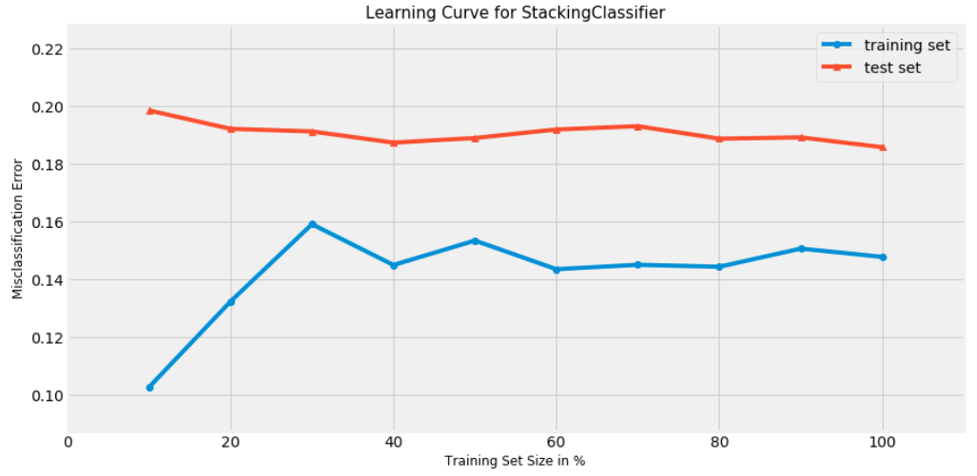
Model Selection – Learning Curve
Stacking Classifier

Slide 21
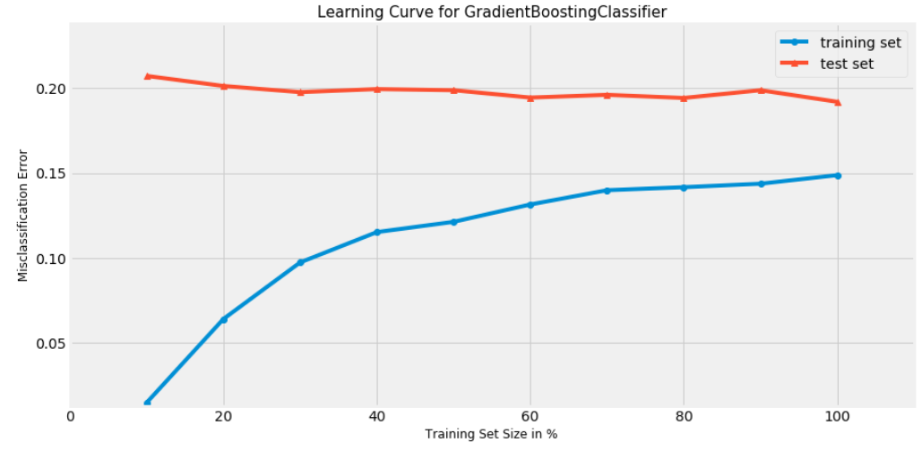
Model Selection – Learning Curve
Gradient Boosting Machine

Slide 22
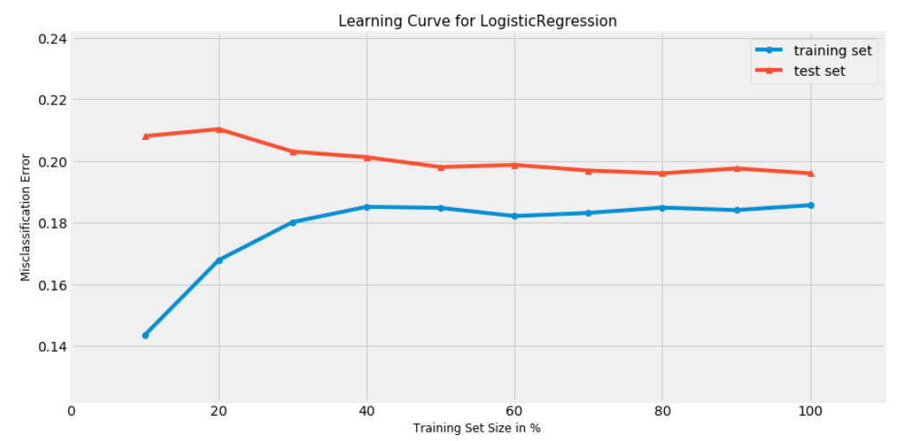
Model Selection – Learning Curve
Logistic Regression

Slide 23
Thank You!

